Slide 1
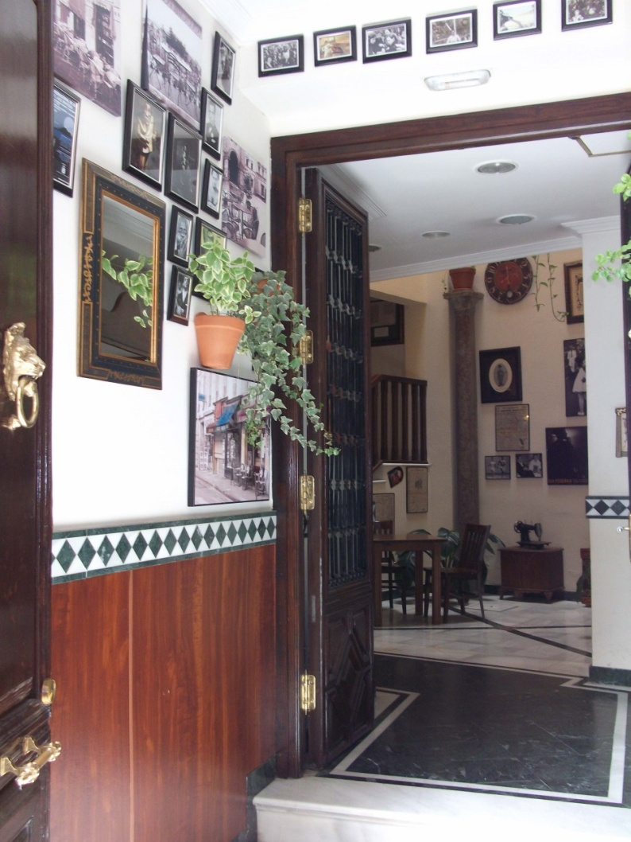
AVOIDING “READY, FIRE, AIM” IN DIAGNOSING WORKPLACE RELATIONSHIPS: Your Guide to Managing Chums. Larry Stybel

Slide 2
GOALS
Differentiatial diagnosis of workplace relationships: friends, allies, chums, colleagues, and enemies.
Understanding how to cultivate chums and the physical/virtual space for chumship.
How companies can help employees manage chumship and why it is important to do so.

Slide 4
PARADOX OF KNOWLEDGE WORK

Slide 5
DIFERENTIAL DIAGNOSIS OF WORKPLACE RELATIONSHIPS?

Slide 6
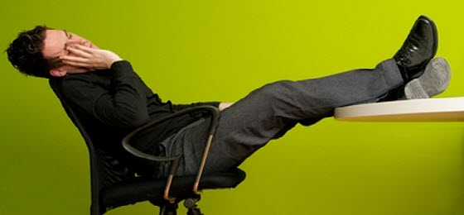
MISSED OPPORTUNITIES FOR PROMOTION FOR THOSE IN COMPLIANCE ORIENTED JOBS.

Slide 7
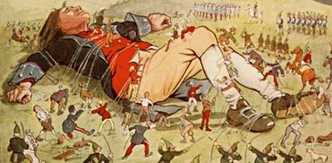
MULTIPLE STRANDS OF CHUMSHIP TIE RELATIONS WITH CUSTOMERS.

Slide 8
TOO GREAT A DEPENDENCY ON SINGLE RAIN MAKERS NOT GOOD FOR PROFESSIONAL SERVICE FIRMS: TESTA

Slide 9
WITHOUT A COMMON LANGUAGE:

Slide 10
 |  |  |  |  |  | RELATIONSHIP MATRIX
 |  |  |  |  | CONDITIONAL AFFECT |  |  |  | UNCONDITIONAL AFFECT
POSITIVE OUTCOMES |  |  |  |  | Chums |  |  |  | Friends
NEUTRAL OUTCOMES |  |  |  |  | Allies |  |  |  | Colleague
NEGATIVE OUTCOMES |  |  |  |  | Adversaries |  |  |  | Enemies

Slide 11
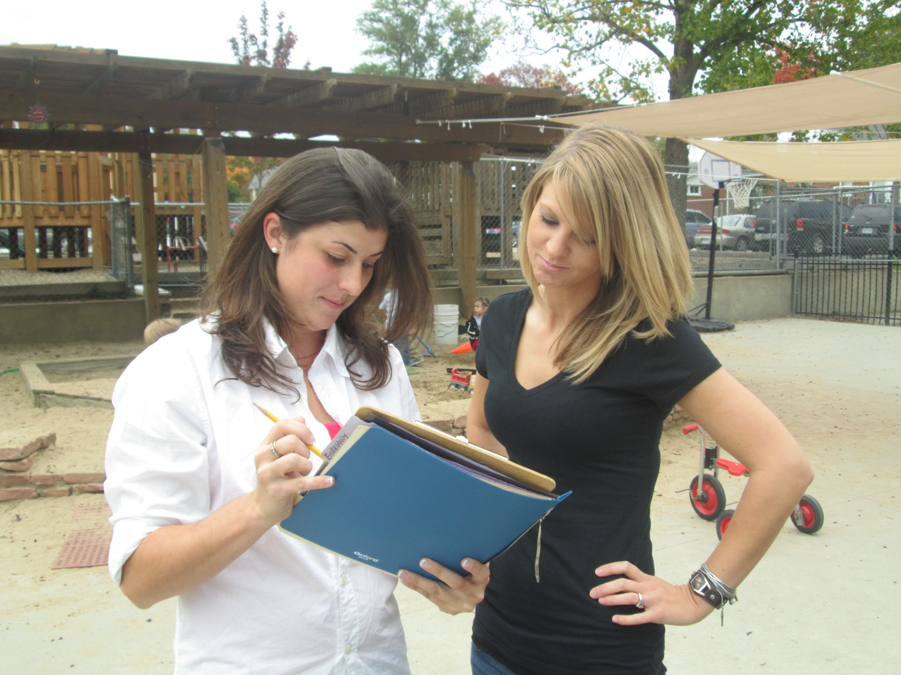
COLLEAGUES: occupying similar space, sharing information. Neutral/Neutral.

Slide 12
FRIENDS: unconditional

Slide 13
ENEMIES: unconditional

Slide 14
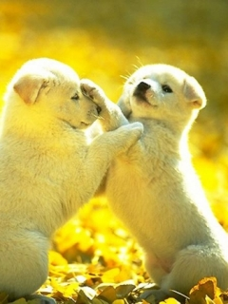
ADVERSARIES: Conditional Opponents: negative outcome but conditional affect.

Slide 15
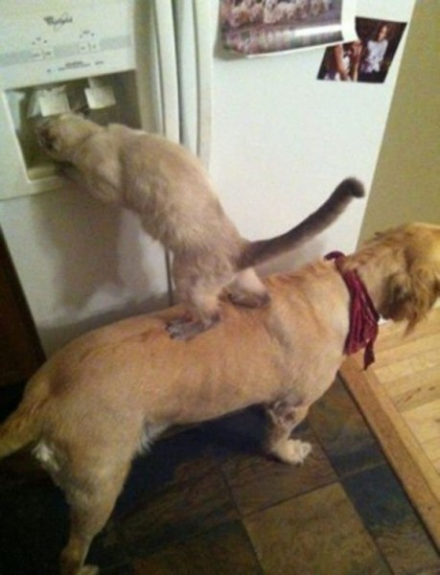
ALLIES: Conditional Cooperation. Neutral/Conditional.

Slide 16
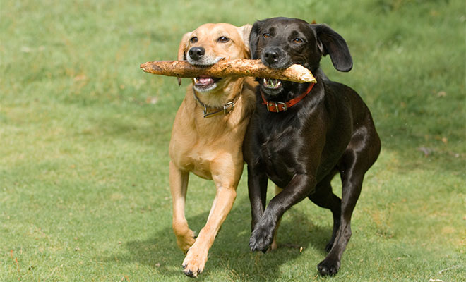
CHUMS: Allies with Benefits

Slide 17
OUR FOCUS IS ON CHUMSHIP: MOST GREAT LEADERS “GET IT.”

Slide 18
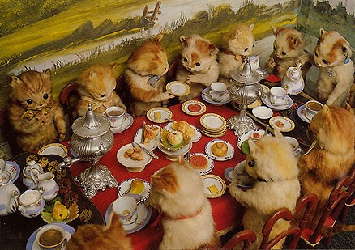
IT’S NOT LONLEY AT THE TOP.

Slide 19
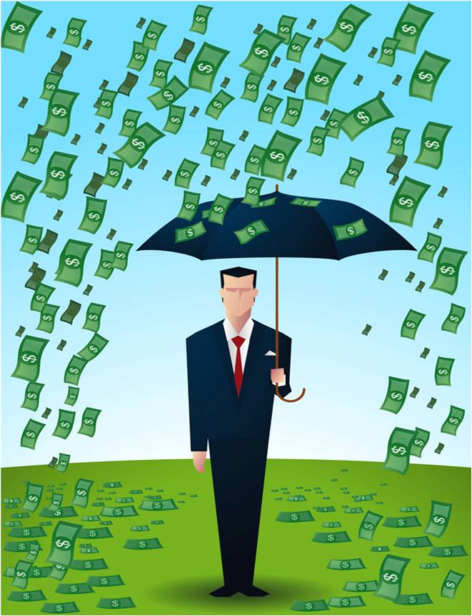
PEOPLE WHO KNOW HOW TO CONVERT ALLIES TO CHUMS ARE

Slide 20
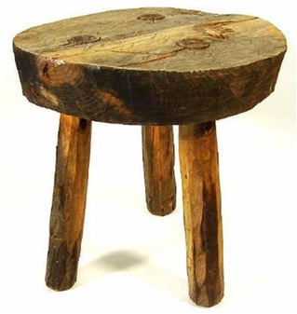
CHUMSHIP HELPS PUT WORK-LIFE TENSION ON A THREE LEGGED FRAMEWORK.

Slide 21
CPA PARTNER LOVES GOLF

Slide 22
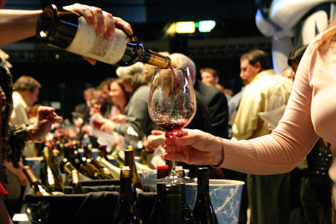
Director of Treasury Likes Fine Wine

Slide 23
THE COURTYARD IS WHERE CHUMSHIP IS CULTIVATED.
Notes:
Role of courtyards to moderate conditions: cool air is warmed before it enters the private space;

Slide 24
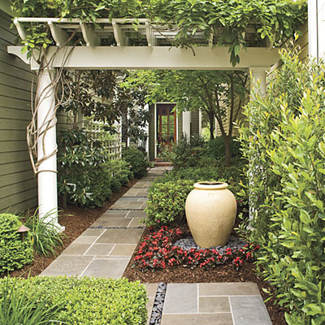
COURTYARDS MODERATE MOOD BEFORE ENTERING PRIVATE SPACE.

Slide 25
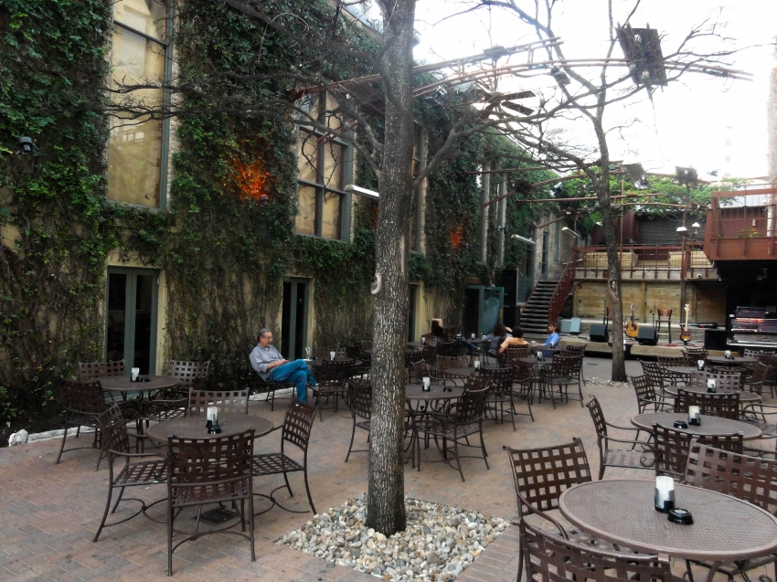
A SPACE THAT IS NOT WORK YET IS NOT PRIVATE.

Slide 26
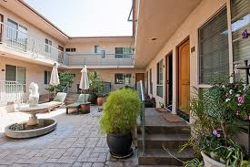
MODERATE TEMPERATURE FOR THE PRIVATE SPACE.

Slide 27
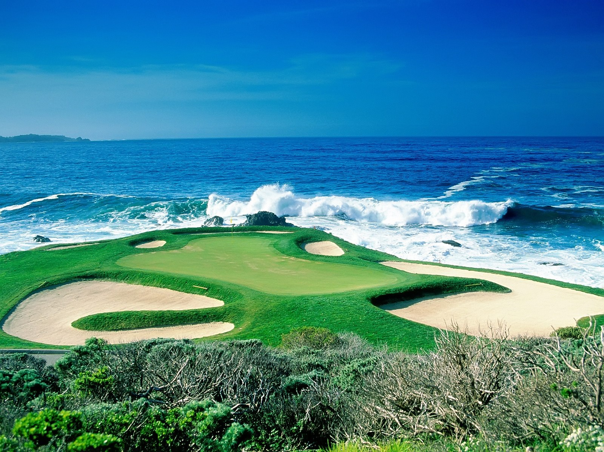
PHYSICAL COURTYARD: GOLF

Slide 28
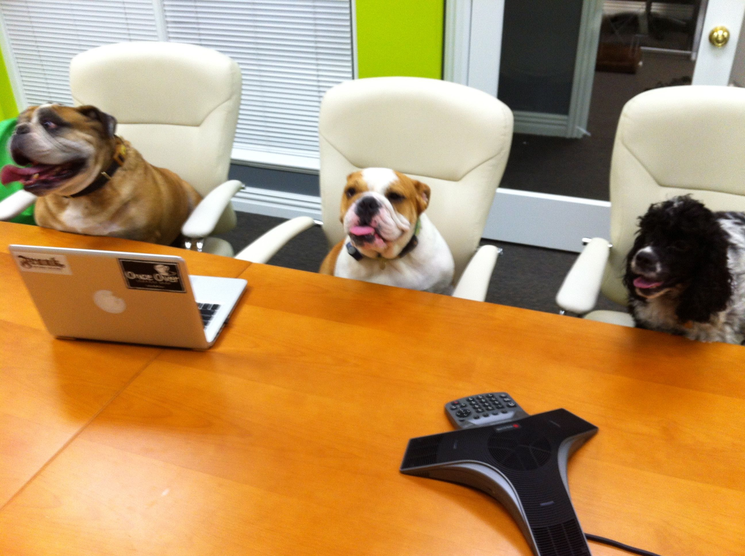
PHYSICAL COURTYARD: Association Committees.

Slide 29
PHYSICAL COURTYARD: Wine Tastings

Slide 30
VIRTUAL COURTYARD: Facebook and Google+

Slide 31
MANAGEMENT OF COURTYARD TIME
Attract and retain business.
Move Work/Life conflict to Home/Work/Courtyard. Courtyard can reduce stress.
Chums give zest to work.
Chums help smooth volatility of career management.

Slide 32
MONDAY MORNING AT 8:00am

Slide 34
For More Information
http://sloanreview.mit.edu/article/is-it-really-lonely-at-the-top/
http://sloanreview.mit.edu/article/friend-foe-ally-adversary-or-something-else/

Slide 35
Larry Stybel, lstybel@stybelpeabody.com

