Slide 1
FAKE IT TILL YOU BECOME IT: CALM ASSERTIVE LEADERSHIP
Larry Stybel,Ed.D.
STYBEL PEABODY ASSOCIATES,
A Lincolnshire Company.

Slide 2
THE LEADER WHO MOST INSPIRED YOU: (BOSS, PARENT, FICTIONAL CHARACTER)

Slide 3
OBJECTIVES FOR YOU TODAY

Slide 4
Origins of Calm/Assertive Leadership.
Tie to neurobiology and to behavioral science.
Examine Calm/Assertive “Scripts” that can be used by you and your team.
Incentivize “Calm/Assertive Leadership” so it is institutionalized into the culture.
Improve your ability to win using Calm/Assertive Leadership.

Slide 5
THIS PROGRAM IS “IDEAS TO ACTION.”

Slide 6
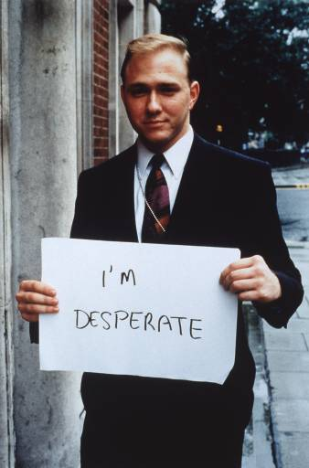
WHAT YOUR STAKEHOLDERS CRAVE FROM YOU:

Slide 7
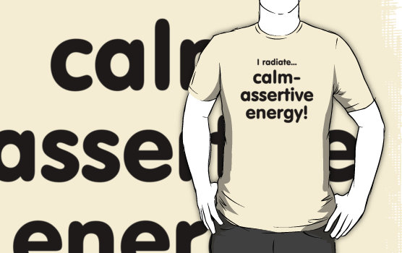

Slide 8
BECAUSE THE WORLD IS SO UNCERTAIN!

Slide 9
ORIGINS

Slide 10
BEHAVIORAL SCIENCE

Slide 11
Journal of Business Psychology, 2010.
Leadership = Communication? The Relations of Leaders’ Communication Styles with Leadership Styles, Knowledge
Sharing and Leadership Outcomes
Reinout E. de Vries • Angelique Bakker-Pieper Wyneke Oostenveld

Slide 12
Study Overview
279 employees in one organization.
charismatic team leaders versus task-oriented team leaders versus “people” oriented team leaders.
Leader Perceived Support and Precision in Feedback Most Linked to Outcome and Perceived Satisfaction.

Slide 13
CALM AND ASSERTIVE

Slide 14
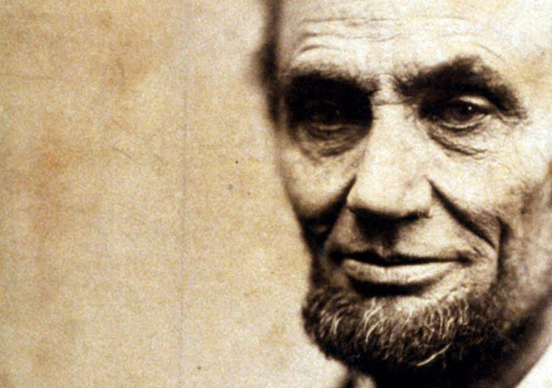

Slide 15
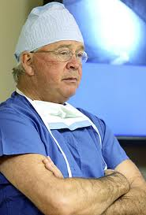

Slide 16
Write Down the Name of a Calm/Assertive Leader you have met.

Slide 17
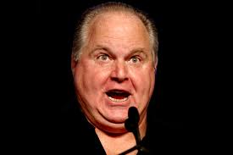
Assertive but Not Calm: Rush Limbaugh.

Slide 18
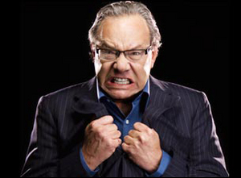
Lewis Black: Calm…Calm….ASSERTIVE

Slide 19
AN ASSERTIVE BUT NOT CALM LEADER IN YOUR LIFE?

Slide 20
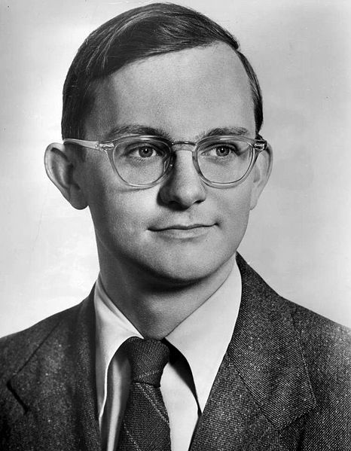
Calm But Not Assertive: Jeff the Nice HR Director.

Slide 21
WRITE DOWN A CALM BUT NOT ASSERTIVE LEADER IN YOUR LIFE.

Slide 22
REVIEW THE NAME OF THE BEST LEADER YOU WORKED WITH IN YOUR LIFE…..

Slide 23
0 1 2 3 4 5 6 7 8 9 10
CALM BUT NOT ASSERTIVE=0
ASSERTIVE BUT NOT CALM=10
How would you evaluate yourself today:
What key stakeholders want you to be:

Slide 24
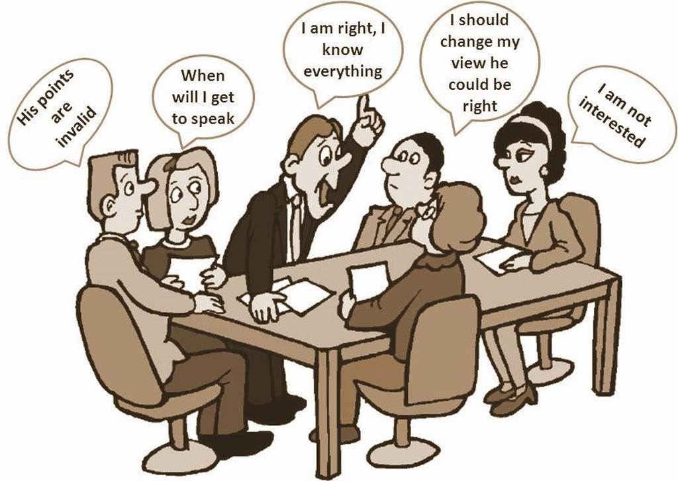

Slide 25
BEHAVIORAL GOAL: 10% IMPROVEMENT.

Slide 26
SCRIPTING FOR CALM/ASSERTIVE LEADERSHIP.

Slide 27
You Are A Consultant and Get an Opportunity for a Prospect Meeting.

Slide 28
THE POTENTIAL CLIENT DISCUSSES THE PROBLEM WITH YOU….

Slide 29
WRITE DOWN AN EXAMPLE OF CALM BUT NOT ASSERTIVE RESPONSE:

Slide 30
GIVE ME AN EXAMPLE OF AN ASSERTIVE BUT NOT CALM RESPONSE.

Slide 31
GIVE ME AN EXAMPLE OF A CALM/ASSERTIVE RESPONSE.

Slide 32
SCRIPTS ARE SO COMMON WE DON’T THINK ABOUT THEM.

Slide 33
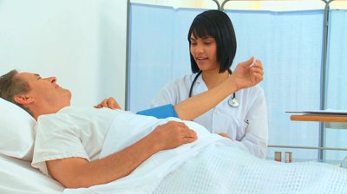

Slide 34
Fake it Until Your Company Becomes It.
Script communications to create the impression that stakeholders are talking with calm/assertive leaders.

Slide 35
VALUE OF MANDATING SCRIPTS
Predictability.
Impersonal.
Explicit Expression of Corporate Values.

Slide 36
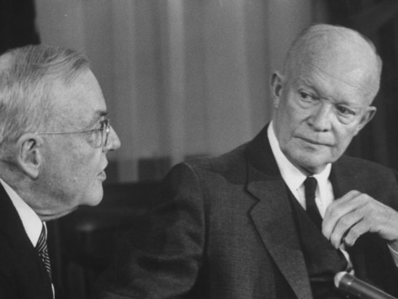
STORY OF PRESIDENT EISENHOWER AND JOHN FOSTER DULLES

Slide 37
SCRIPTS FOR YOUR TEAM
Talk like a TV weatherman: “Based on past history in projects similar to yours, I believe that there is an 80% chance of success.”
“No problem!”
“We will do our best….”

Slide 38
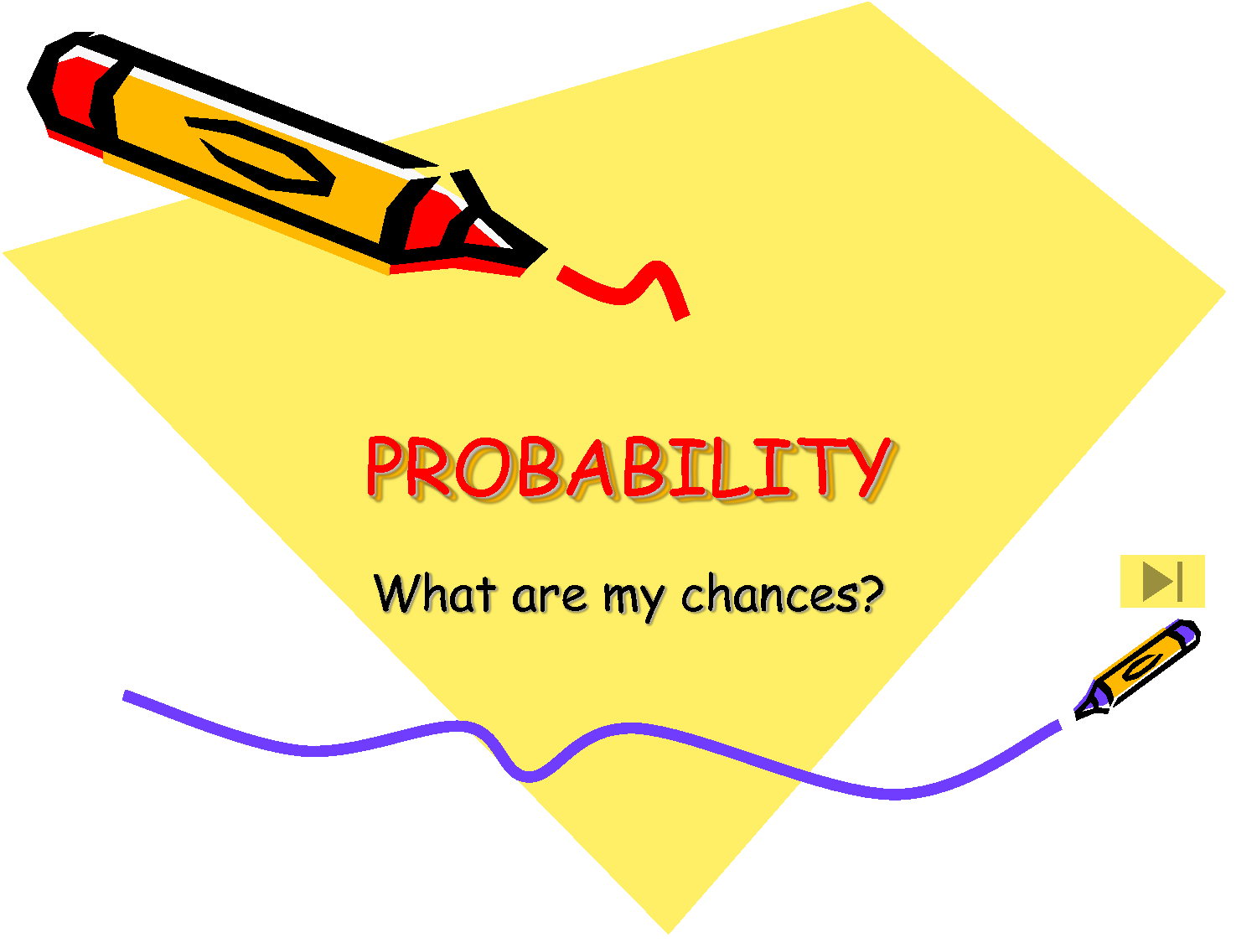
CAN YOU WRITE DOWN AN EXAMPLE IN YOUR BUSINESS:

Slide 39
Scripts
“Of course WE think we are the best for you. But if there is another organization with a program that is a better fit, I’ll make a referral.

Slide 40
VERY Powerful Calm/Assertive Tool: Paraphrase.
“I will summarize what I have heard you say to make sure I “get it.” And then I will explain how we might be of value…….

Slide 41
Exercise
Write down something you can do next week that might involve paraphrasing.

Slide 42
KILLER CLOSE TO SHOW YOU ARE CALM AND ASSERTIVE:
“My last question is the most important: what questions have I failed to ask that I should have asked to better understand the situation and your needs?”

Slide 44
INSTITUTIONALIZE CALM/ASSERTIVE LEADERSHIP.

Slide 45
HIRING CALM/ASSERTIVE LEADERS
Reference Check Questions: give me an example of how the candidate has acted during a crisis or when things were not going well.
Give me an example of how the candidate expresses him/herself when the candidate’s ideas are not necessarily popular.

Slide 46
INSTITUTIONALIZING CALM/ASSERTIVE LEADERSHIP: performance appraisals.
Employee expresses ideas in probability statements. 0 (never) to 10 (always).
Employee paraphrases the ideas of others. 0 (never) to 10 (always).
Employee conveys a sense of being calm. 0 (never) to 10 (always).

Slide 47
INSTITUTIONALIZING CALM ASSERTIVE LEADERSHIP.
Create scripts and mandate the use.
Fake it until you become it.

Slide 48
COMPENSATING CALM/ASSERTIVE LEADERS
Is it part of the compensation plan?
The percentage is less important than the fact that it “counts.”

Slide 49
INSTITUTIONALIZING CALM/ASSERTIVE LEADERSHIP.
Ask team members to express their confidence level in percentages and then hold them accountable.
Use paraphrasing.
Script for yourself the last five minutes of a meeting: what questions have I not asked that I should have asked?”

Slide 50
Write Down a Specific Action You Can Take Next Week.

Slide 52
CALM/ASSERTIVE:

Slide 53
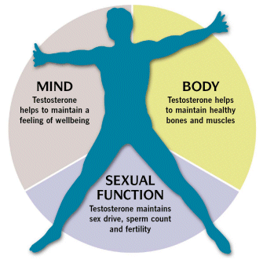
HIGH LEVELS OF

Slide 54
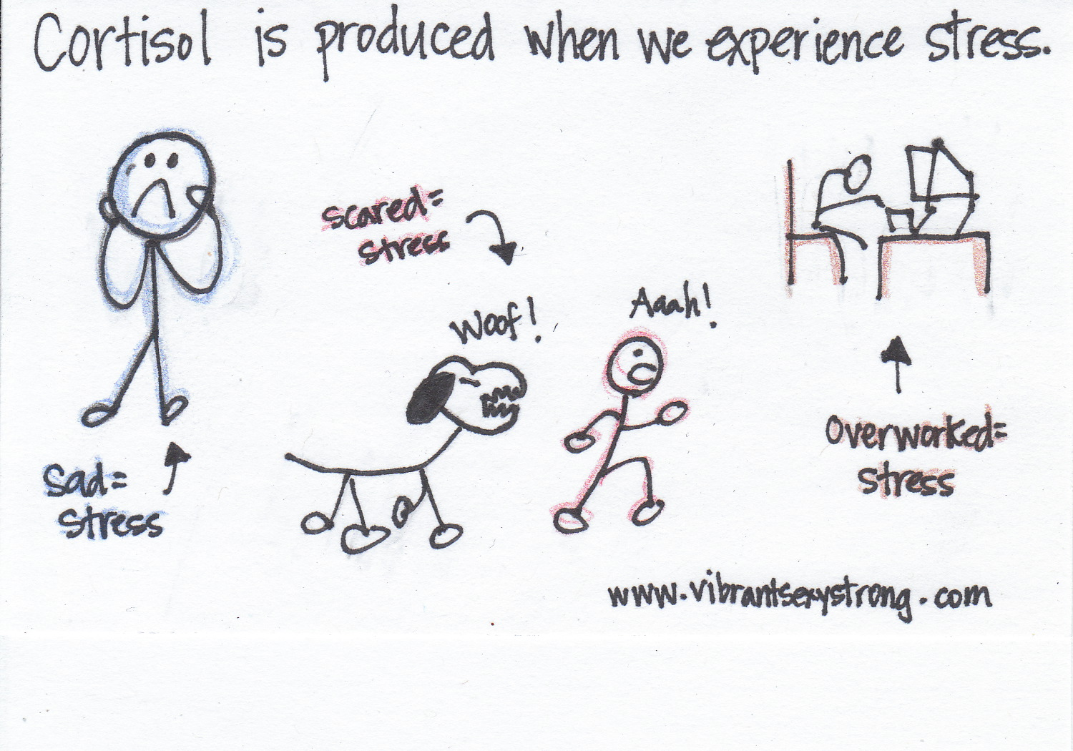
LOW LEVELS OF

Slide 55
YOUR BRAIN CONTAINS FEEDBACK LOOPS RUNNING IN MANY DIRECTIONS…

Slide 56
AMY CUDDY, PH.D. HARVARD UNIVERSITY
http://www.youtube.com/watch?v=Ks-_Mh1QhMc

Slide 57
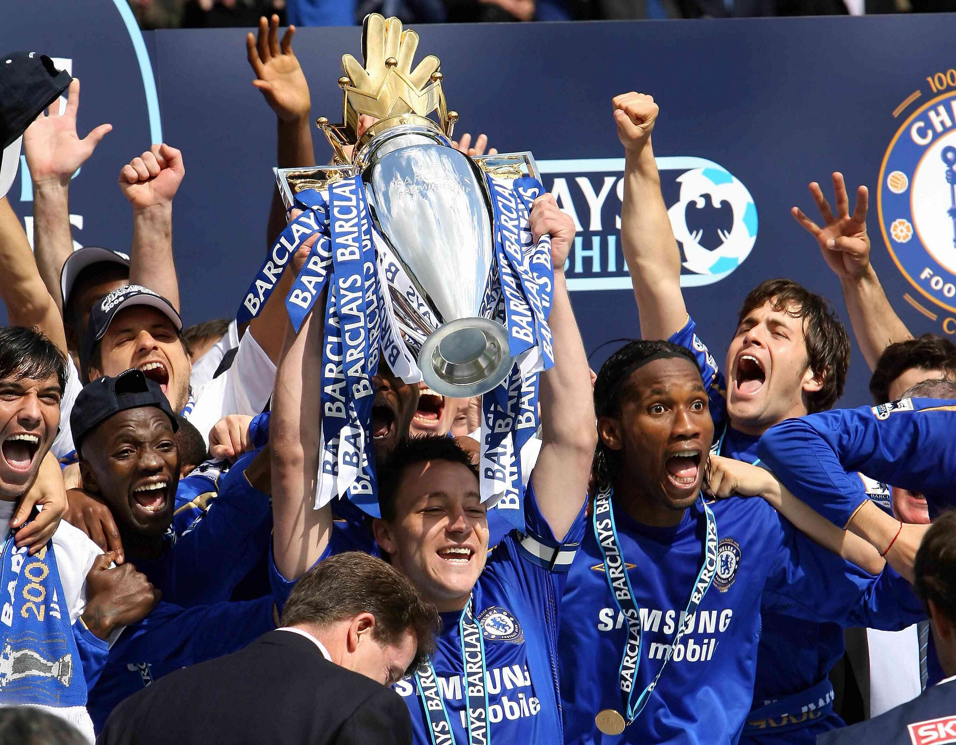

Slide 58
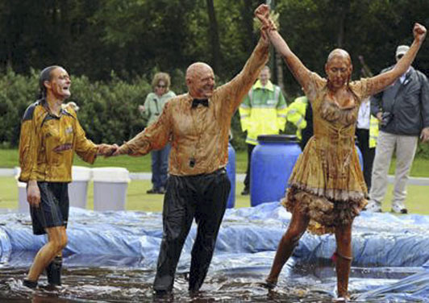

Slide 59
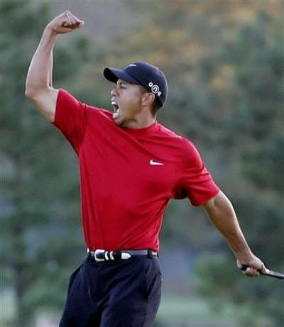

Slide 61
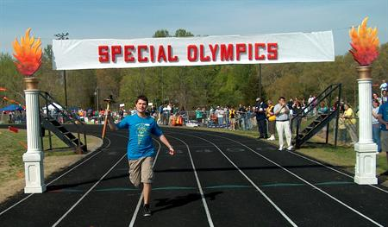

Slide 65
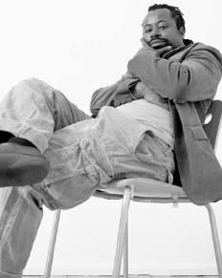

Slide 66
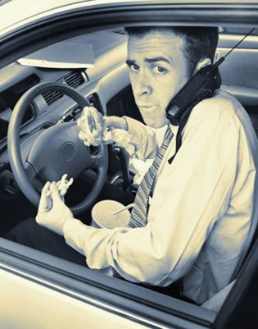
LARRY GOES ON A SALES CALL.

Slide 67
IMPLICATIONS
You can fake it until you become it.
Avoid postures that stimulate cortisol.
Engage in postures that stimulate testosterone.
Make this a part of your check list when making sales calls or going to meetings.

Slide 68
SUMMARY
Origins of Calm/Assertive Leadership.
Tie to neurobiology and behavioral science.
Examine Calm/Assertive “Scripts” that can be used by you and your team.
Institutionalize use of scripts;
Incentivize “Calm/Assertive Leadership” so it is institutionalized into the culture.
Hire calm assertive leaders.

Slide 69
SUMMARY
Create opportunities to use non chemical body posture to stimulate testosterone. Make it a check list item on your calendar.
Watch yourself for body postures that will increase cortisol.
Watch for decisions made while in a high cortisol inducing body position, e.g. in a car or airplane.

Slide 71
One hour free consult by phone to turn ideas into action.
Give us your business card for a copy of this presentation.

Slide 72
PSYCHOLOGY TODAY MAGAZINE
http://www.psychologytoday.com/blog/platform-success/201303/people-want-follow-calm-assertive-leaders
http://www.psychologytoday.com/blog/platform-success

Slide 73
